Slide 1
Chapter 2 figures

Slide 2
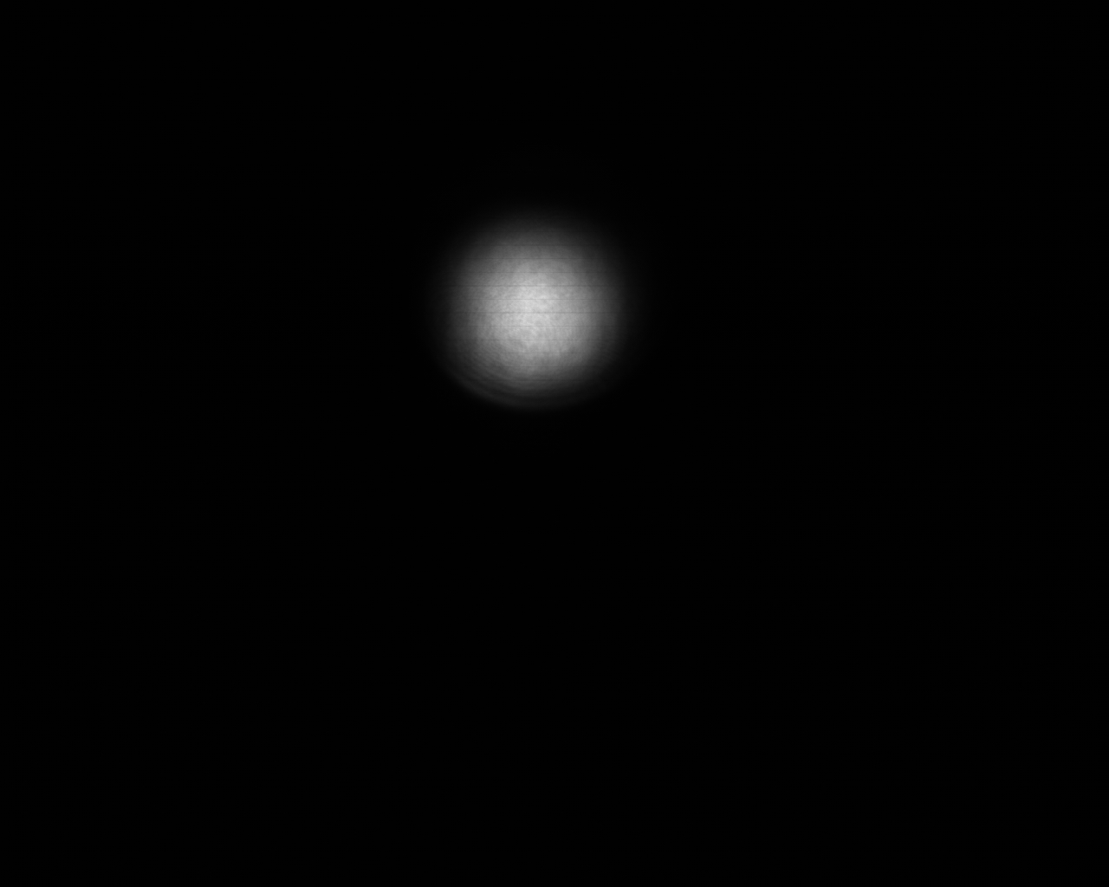
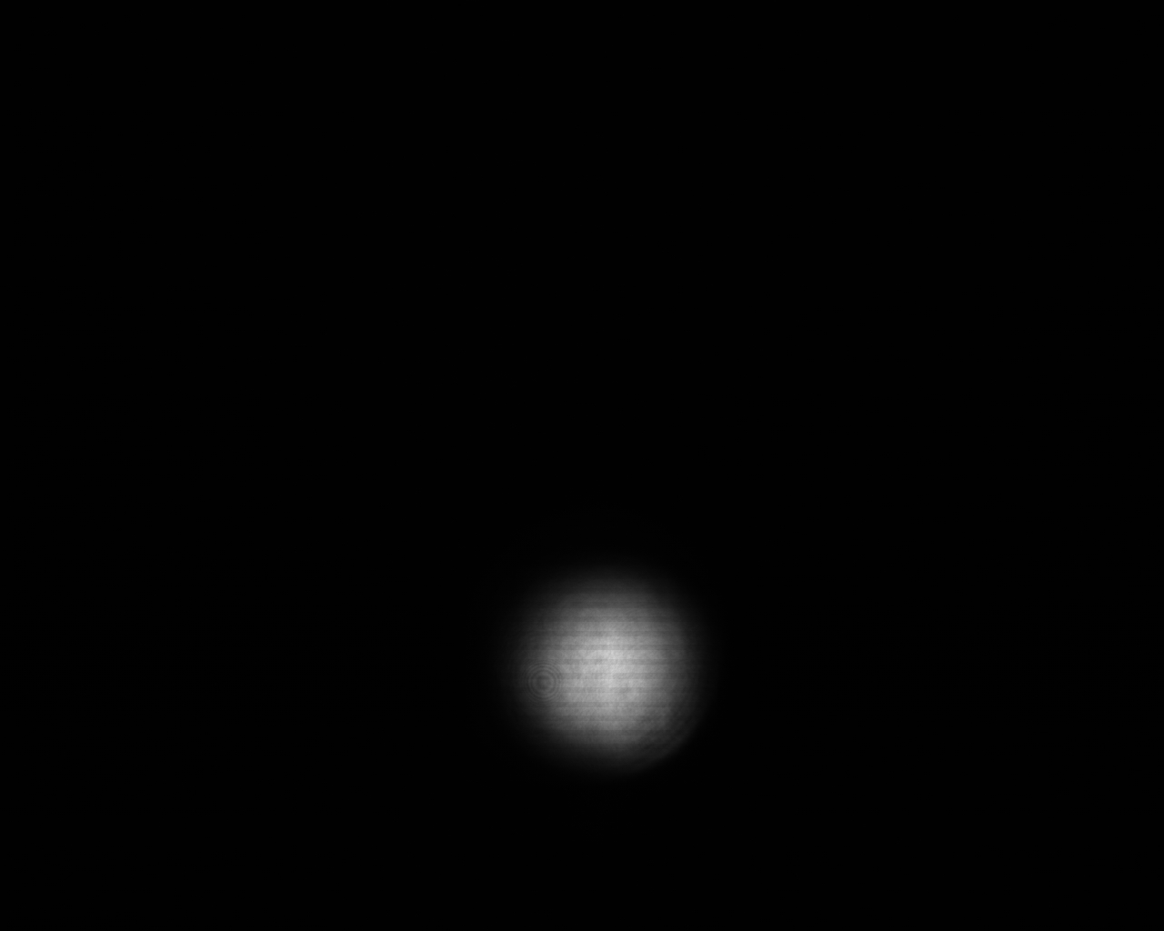
GuideStar Geometry
M0: Dietrich’s motorized mirror
C0: Dietrich’s camera
M1,M2: GuideStar II motorized mirrors
C1,C2: GuideStar II cameras
W: window
SF
C0
M2
W
C1
M0
M1
Ext. Comp.
C2
Cam1
OPA
Cam2

Slide 3
SF
C0
M2
W
C1
M0
M1
Ext. Comp.
C2
Cam1
OPA
Cam2

Slide 4
P
P
1300 iP
G
D65B
WSU501
400 iP
DP₁
P
700 iP
M
DP groove
P
1300 iP
P
T
D65B
WA251
T400i
DP₂
P
400 iP
S
DP groove

Slide 5

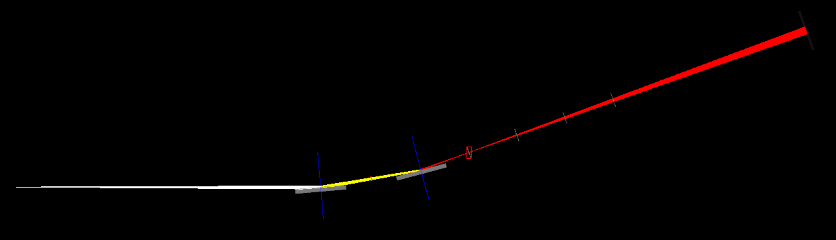
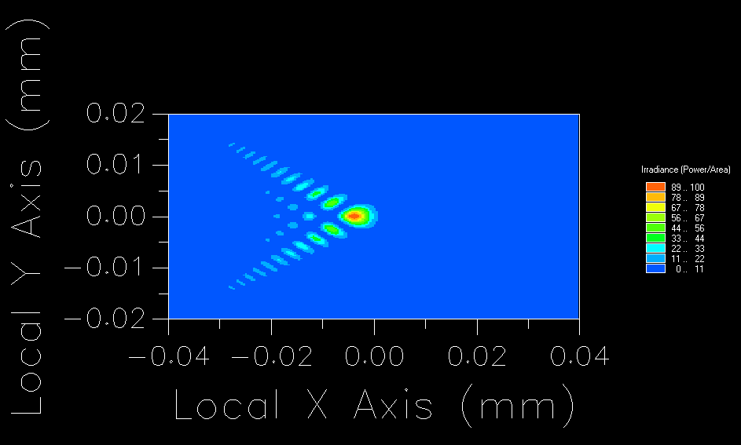
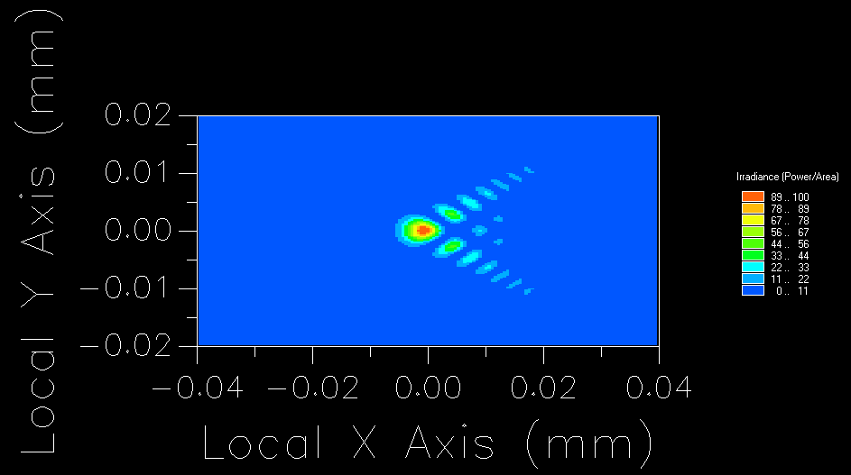
Single Toroid Mirror (TM) Configurations (M=2 or 3)
TM1: $r=150cm$, $r’=50cm$
TM1: $r=150cm$, $r’=75cm$
l₂=50 cm
l₁=150 cm
75cm
focus
150cm
source
TM
TM
FM
Intensity at focus
f-f configuration

Slide 6
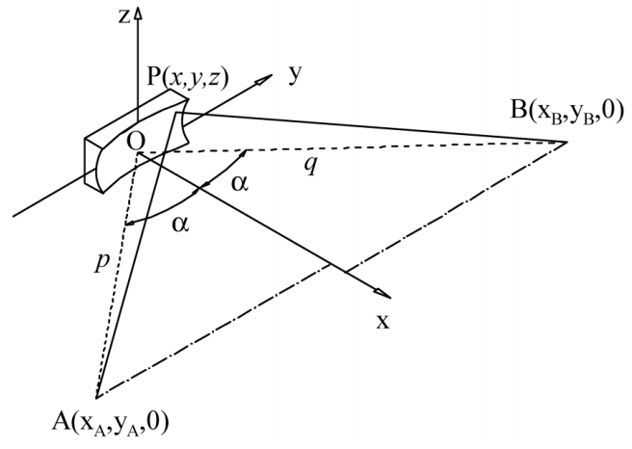




$$l_{2}$$
$$\frac{π}{2}−α$$
$$\frac{π}{2}−α$$
$$l_{1}$$

